Slide 1



“Cadet college Sanghar.”

Slide 2
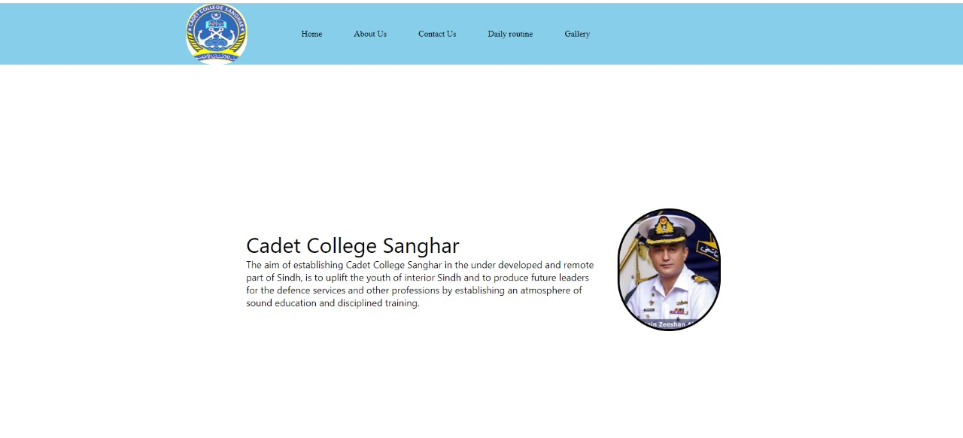
Home Page
This our Home Page.
Here is our Faculty’s Message for the Students.

Slide 3
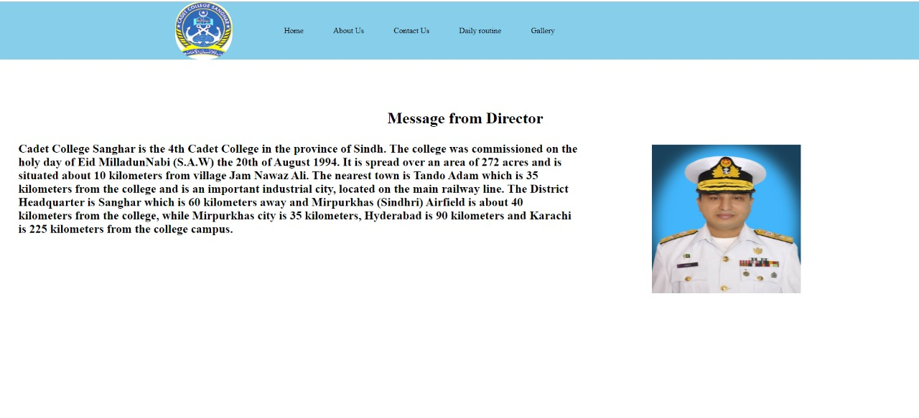
About us
This our About us PAGE.
Here is Our Chairman Board of Governor’s Message about Cadet College.

Slide 4
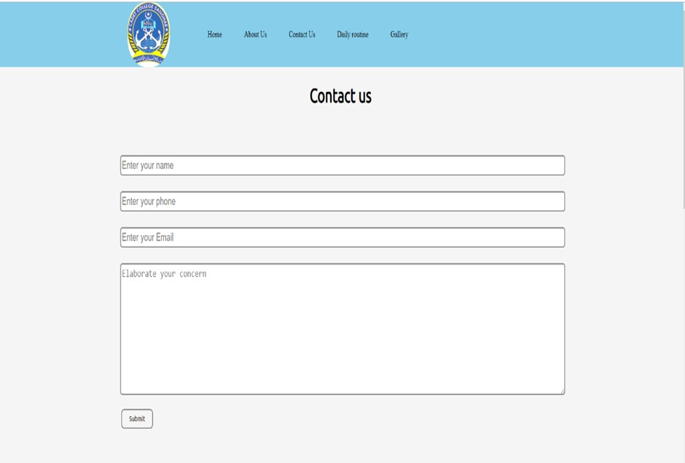
Contact us
This is our contact us page.
Where users can contact us.
For Admissions and any queries.

Slide 5
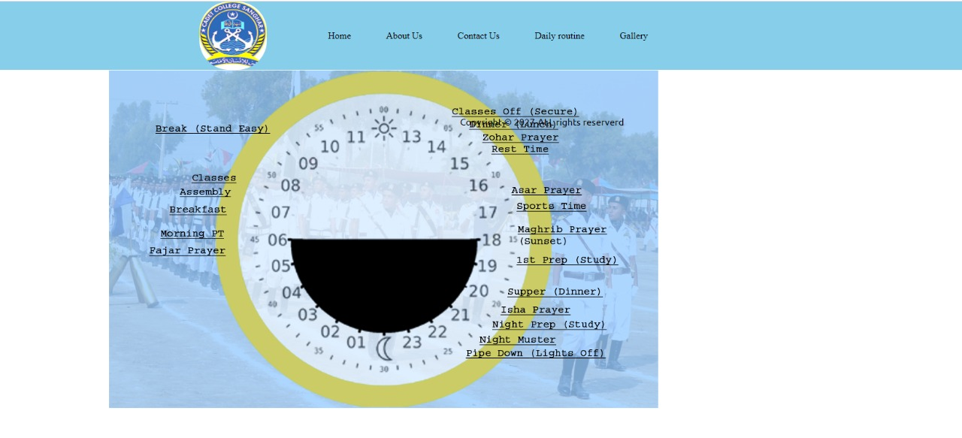
Daly Routine
This is Daily Routine Page.
Here Cadet’s Daily Routine is Shown.

Slide 6
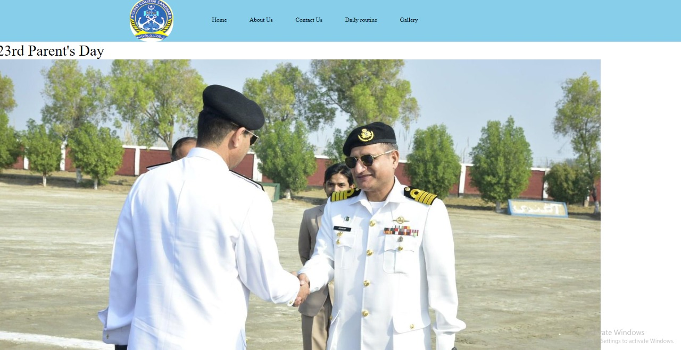
Gallery
This our gallery page.
Here are some Pictures realated our college.

Slide 7

Good bye.
I Hope you Love Our Presentation as well as Our Project.
Please Appreciate our Hard Work.
It Will Keep Us Motivated.
Thank YOU For Having Us Here. By:-
abdul wahab sehgal (cs-211178)
Abdul BasIT (CS-211190)

